Slide 1

Chapter 10 Thinking in Objects

Slide 2
Motivations
You see the advantages of object-oriented programming from the preceding two chapters. This chapter will demonstrate how to solve problems using the object-oriented paradigm. Before studying these examples, we first introduce several language features for supporting these examples.

Slide 3
Objectives
To create immutable objects from immutable classes to protect the contents of objects (§10.2).
To determine the scope of variables in the context of a class (§10.3).
To use the keyword this to refer to the calling object itself (§10.4).
To apply class abstraction to develop software (§10.5).
To explore the differences between the procedural paradigm and object-oriented paradigm (§10.6).
To develop classes for modeling composition relationships (§10.7).
To design programs using the object-oriented paradigm (§§10.8-10.10).
To design classes that follow the class-design guidelines (§10.11).

Slide 4
Immutable Objects and Classes
If the contents of an object cannot be changed once the object is created, the object is called an immutable object and its class is called an immutable class. If you delete the set method in the Circle class in the preceding example, the class would be immutable because radius is private and cannot be changed without a set method.
A class with all private data fields and without mutators is not necessarily immutable. For example, the following class Student has all private data fields and no mutators, but it is mutable.

Slide 5
Example
public class BirthDate {
private int year;
private int month;
private int day;
public BirthDate(int newYear,
int newMonth, int newDay) {
year = newYear;
month = newMonth;
day = newDay;
}
public void setYear(int newYear) {
year = newYear;
}
}
public class Student {
private int id;
private BirthDate birthDate;
public Student(int ssn,
int year, int month, int day) {
id = ssn;
birthDate = new BirthDate(year, month, day);
}
public int getId() {
return id;
}
public BirthDate getBirthDate() {
return birthDate;
}
}
public class Test {
public static void main(String[] args) {
Student student = new Student(111223333, 1970, 5, 3);
BirthDate date = student.getBirthDate();
date.setYear(2010); // Now the student birth year is changed!
}
}

Slide 6
What Class is Immutable?
For a class to be immutable, it must mark all data fields private and provide no mutator methods and no accessor methods that would return a reference to a mutable data field object.

Slide 7
Scope of Variables
The scope of instance and static variables is the entire class. They can be declared anywhere inside a class.
The scope of a local variable starts from its declaration and continues to the end of the block that contains the variable. A local variable must be initialized explicitly before it can be used.

Slide 8
The this Keyword
The this keyword is the name of a reference that refers to an object itself. One common use of the this keyword is reference a class’s hidden data fields.
Another common use of the this keyword to enable a constructor to invoke another constructor of the same class.

Slide 9
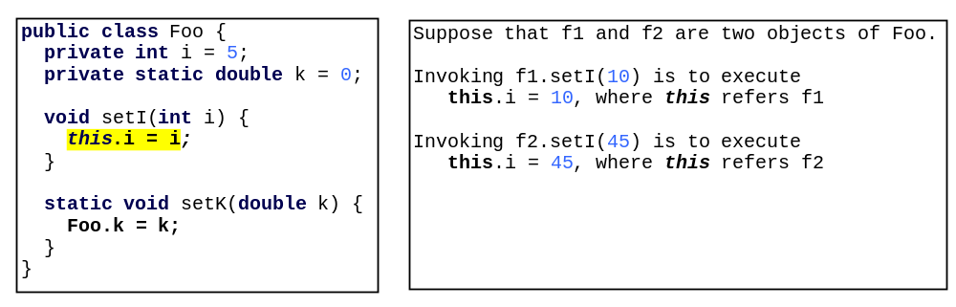
Reference the Hidden Data Fields

Slide 10

Calling Overloaded Constructor

Slide 11

Class Abstraction and Encapsulation
Class abstraction means to separate class implementation from the use of the class. The creator of the class provides a description of the class and let the user know how the class can be used. The user of the class does not need to know how the class is implemented. The detail of implementation is encapsulated and hidden from the user.

Slide 12
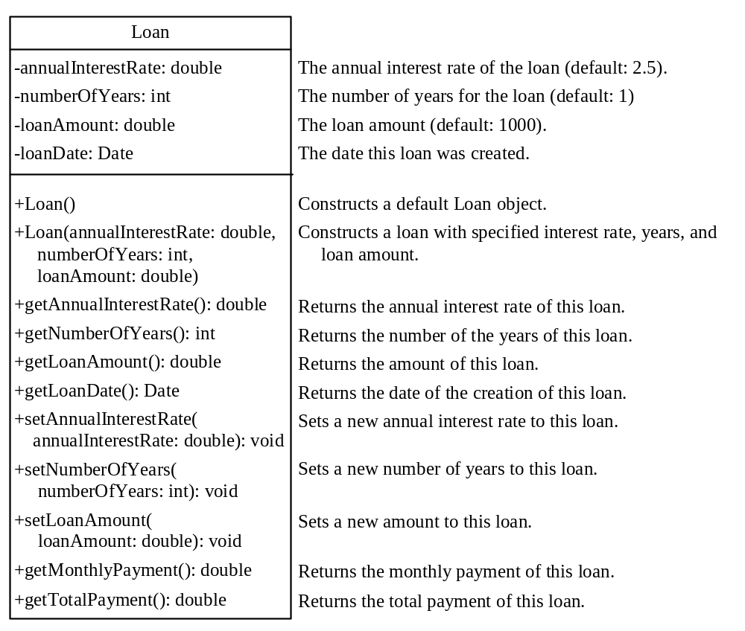
Designing the Loan Class
Loan
TestLoanClass
Run

Slide 13
Object-Oriented Thinking
Chapters 1-6 introduced fundamental programming techniques for problem solving using loops, methods, and arrays. The studies of these techniques lay a solid foundation for object-oriented programming. Classes provide more flexibility and modularity for building reusable software. This section improves the solution for a problem introduced in Chapter 3 using the object-oriented approach. From the improvements, you will gain the insight on the differences between the procedural programming and object-oriented programming and see the benefits of developing reusable code using objects and classes.

Slide 14
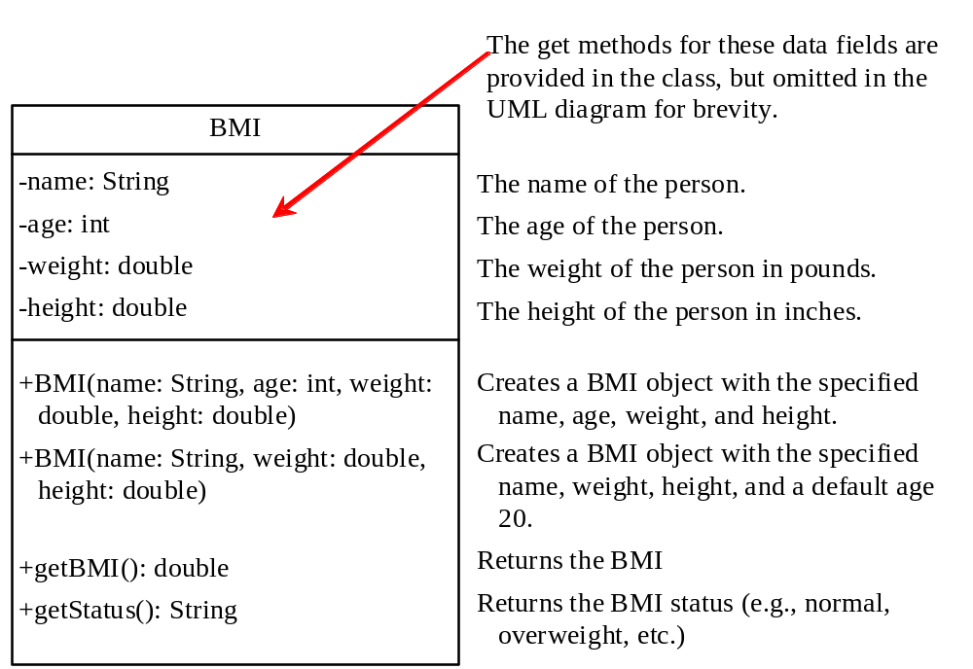
The BMI Class
BMI
UseBMIClass
Run

Slide 15
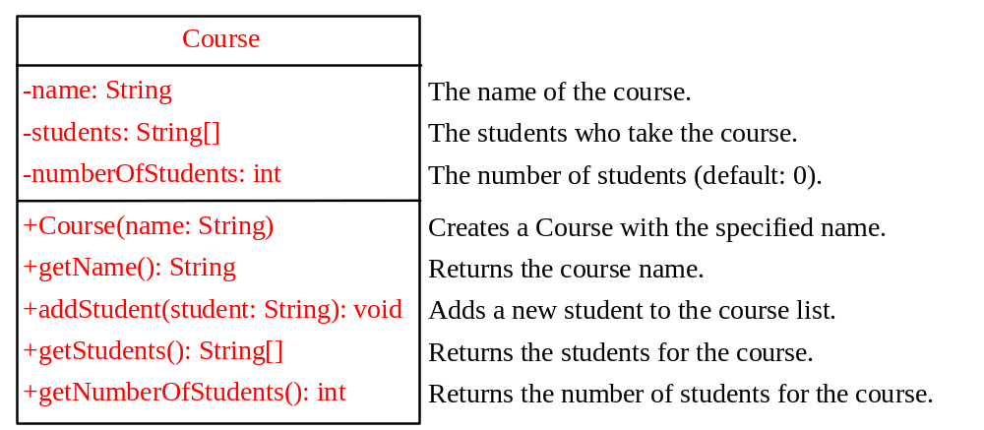
Example: The Course Class
Course
TestCource
Run

Slide 16

Example: The StackOfIntegers Class
TestStackOfIntegers
Run

Slide 17
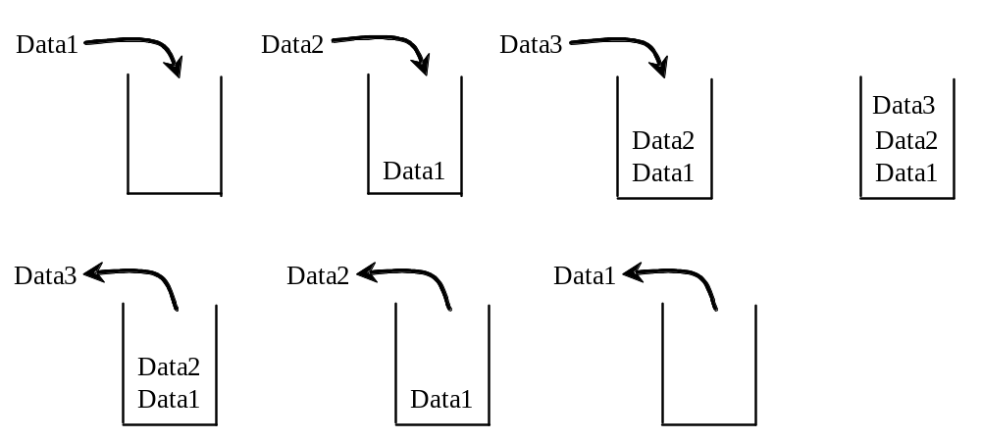
Designing the StackOfIntegers Class

Slide 18
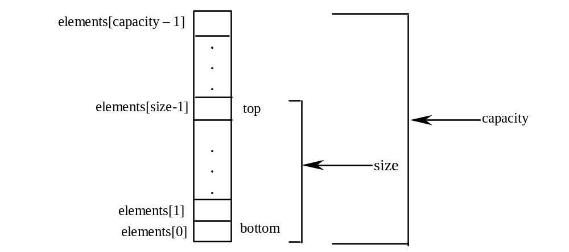
Implementing StackOfIntegers Class
StackOfIntegers

Slide 19
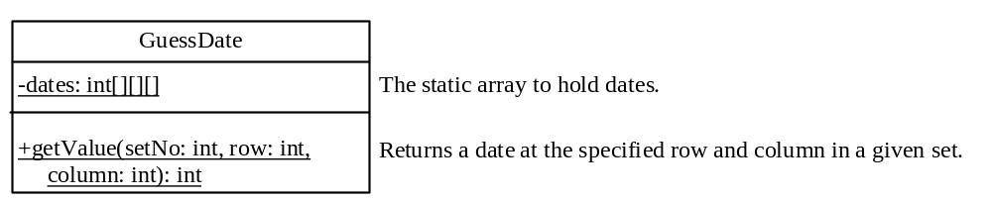
Designing the GuessDate Class
GuessDate
UseGuessDateClass
Run

Slide 20
Designing a Class
(Coherence) A class should describe a single entity, and all the class operations should logically fit together to support a coherent purpose. You can use a class for students, for example, but you should not combine students and staff in the same class, because students and staff have different entities.

Slide 21
Designing a Class, cont.
(Separating responsibilities) A single entity with too many responsibilities can be broken into several classes to separate responsibilities. The classes String, StringBuilder, and StringBuffer all deal with strings, for example, but have different responsibilities. The String class deals with immutable strings, the StringBuilder class is for creating mutable strings, and the StringBuffer class is similar to StringBuilder except that StringBuffer contains synchronized methods for updating strings.

Slide 22
Designing a Class, cont.
Classes are designed for reuse. Users can incorporate classes in many different combinations, orders, and environments. Therefore, you should design a class that imposes no restrictions on what or when the user can do with it, design the properties to ensure that the user can set properties in any order, with any combination of values, and design methods to function independently of their order of occurrence.

Slide 23
Designing a Class, cont.
Provide a public no-arg constructor and override the equals method and the toString method defined in the Object class whenever possible.

Slide 24
Designing a Class, cont.
Follow standard Java programming style and naming conventions. Choose informative names for classes, data fields, and methods. Always place the data declaration before the constructor, and place constructors before methods. Always provide a constructor and initialize variables to avoid programming errors.

Slide 25
Using Visibility Modifiers
Each class can present two contracts – one for the users of the class and one for the extenders of the class. Make the fields private and accessor methods public if they are intended for the users of the class. Make the fields or method protected if they are intended for extenders of the class. The contract for the extenders encompasses the contract for the users. The extended class may increase the visibility of an instance method from protected to public, or change its implementation, but you should never change the implementation in a way that violates that contract.

Slide 26
Using Visibility Modifiers, cont.
A class should use the private modifier to hide its data from direct access by clients. You can use get methods and set methods to provide users with access to the private data, but only to private data you want the user to see or to modify. A class should also hide methods not intended for client use. The gcd method in the Rational class in Example 11.2, “The Rational Class,” is private, for example, because it is only for internal use within the class.

Slide 27
Using the static Modifier
A property that is shared by all the instances of the class should be declared as a static property.

